Slide 1


PAYSWIFT GHANA
FINTECH COMPANY
Mena Mensiwa Kumi
Data Analyst
mena.kumi@genstudent.org

Slide 2

CONTENTS
1. Introduction
2. Business Challenges
3. Overall Insights & Recommendations
4. Final Takeaways

Slide 3
01
Introduction
PaySwift Ghana is a small fintech company that provides:
• Mobile payment solutions for businesses
• Micro-loans and credit scoring services
• Personal finance management tools

Slide 4
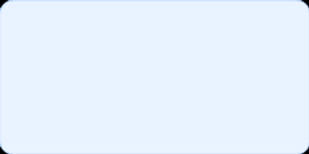
Business Challenges
Why are customers defaulting on loans?
Why are customers leaving the platform?
How can digital product usage and UX design be improved?

Slide 5




01
Why are customers defaulting on loans?
Average Default Risk is 3.28 Showing medium-high risk across the board.
Age vs. Repayment Status
Users aged 25–35 are the ones that default the most.
Users by Feature Used
The most used feature is the loan service which is dominating. Heavy focus on borrowing may encourage over-leveraging.

Slide 6
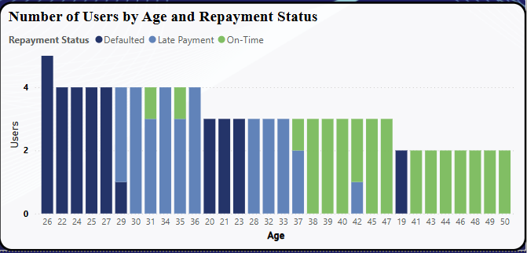
DEFAULTS
Users aged 25–35 show higher default and late payment rates, especially compared to users over 40.
Lack of Automated Reminders – Forgetting due dates leads to avoidable defaults
Irregular Income or Financial Strain – Users may lack stable cash flow to repay consistently
RECOMMENDATIONS:
Automated Payment Reminders
Flexible Repayment Options

Slide 7

02
Why are customers leaving the platform?
Low use of other features (Savings Tracker, Investment Advice):
Implies poor engagement beyond loans.
Churn Pie Chart:
66% churned — that's major.
Distribution of Repayment vs. Transactions:
Spiky usage could mean people come only for loans, then leave.

Slide 8
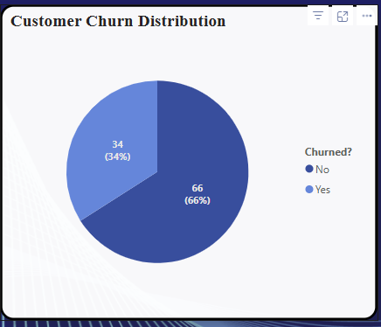
Churn Distribution
66% of users have stopped using the platform that’s two-thirds of our user base, which reflects missed opportunities.
Users don’t see the value beyond loans either because it's not communicated well or not integrated into their behavior.
Recommendations:
Targeted Re-Engagement Messages
Loyalty & Rewards Program

Slide 9
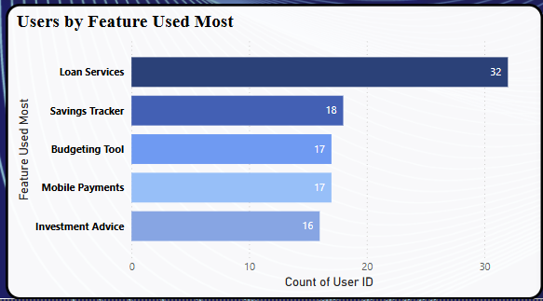
Features Most Used
.
Loan services are the most-used feature (32 users), while tools like savings, budgeting, mobile payments, and investment advice show lower engagement (16–18 users), indicating a lack of personalization.
Recommendations:
Encourage users to explore new tools by linking them to existing behaviors and also educate users on the long-term benefits of other feature

Slide 10

03
UX FEATURE ADOPTION
Feature Highlights & Tooltips
Simplified Navigation & Dashboards
Onboarding Checklist
Usage-Based Personalization

Slide 11
STRATEGIC TAKEAWAYS
To address loan defaults, customer churn, and low feature adoption, I recommend the following:
Reduce Loan Defaults by sending automated payment reminders, offering flexible repayment options, and providing personalized financial guidance. Use risk scoring to limit loan amounts for high-risk users.
Improve Customer Retention through loyalty and rewards programs, targeted re-engagement messages for inactive users, and accessible financial education. Enhancing in-app support will also strengthen user trust.
Boost Feature Adoption and UX by promoting underused tools like savings and budgeting through tooltips and banners, simplifying app navigation, and guiding users with onboarding checklists. Personalizing suggestions based on user behavior will further increase engagement.

Slide 12

Thank You

